Slide 1
Adversarial Robustness in the Streaming Model

Slide 2

Model #1: Streaming Model
Input: Elements of an underlying data set $S$, which arrives sequentially
Output: Evaluation (or approximation) of a given function
Goal: Use space sublinear in the size $m$of the input $S$
1 0 1 1 1 0 0 1
Notes:
Let’s start by breaking down each of the terms in the title. To understand the sliding window model, we first have to understand the streaming model of computation, in which elements of an underlying data set S, arrive sequentially and the goal is to evaluate or approximate some given function on this dataset, using space sublinear in S. In the sliding window model, only the W most recent updates form the underlying data set

Slide 3
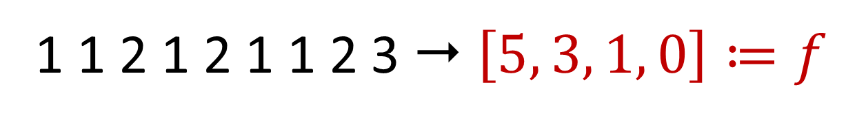

Heavy-Hitters
Given a set $S$ of $m$ elements from $[n]$, let $f_{i}$ be the frequency of element $i$. (How often it appears)
1 1 2 1 2 1 1 2 3  $\left[5, 3, 1, 0\right]≔f$

Slide 4

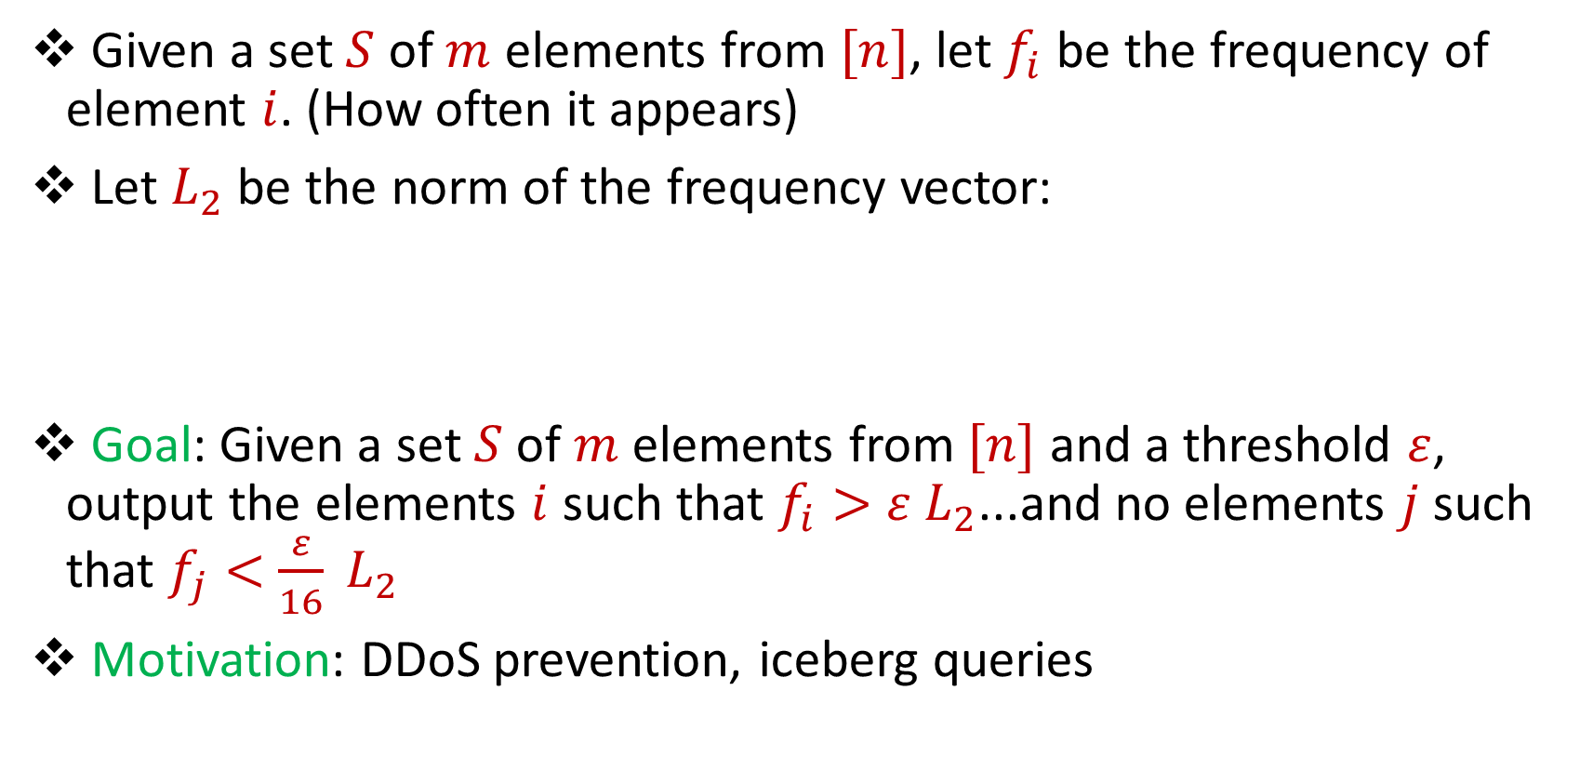
Heavy-Hitters
Given a set $S$ of $m$ elements from $[n]$, let $f_{i}$ be the frequency of element $i$. (How often it appears)
Let $L_{2}$ be the norm of the frequency vector:
Goal: Given a set $S$ of $m$ elements from $[n]$ and a threshold $ε$, output the elements $i$ such that $f_{i}>$ $ε L_{2}$...and no elements $j$ such that $f_{j}<$ $\frac{ε}{16} L_{2}$
Motivation: DDoS prevention, iceberg queries
$$L_{2}=\sqrt{f_{1}^{2}+f_{2}^{2}+…+f_{n}^{2}}$$

Slide 5
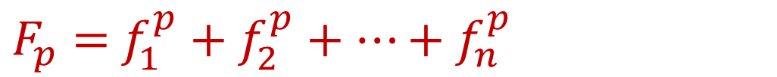
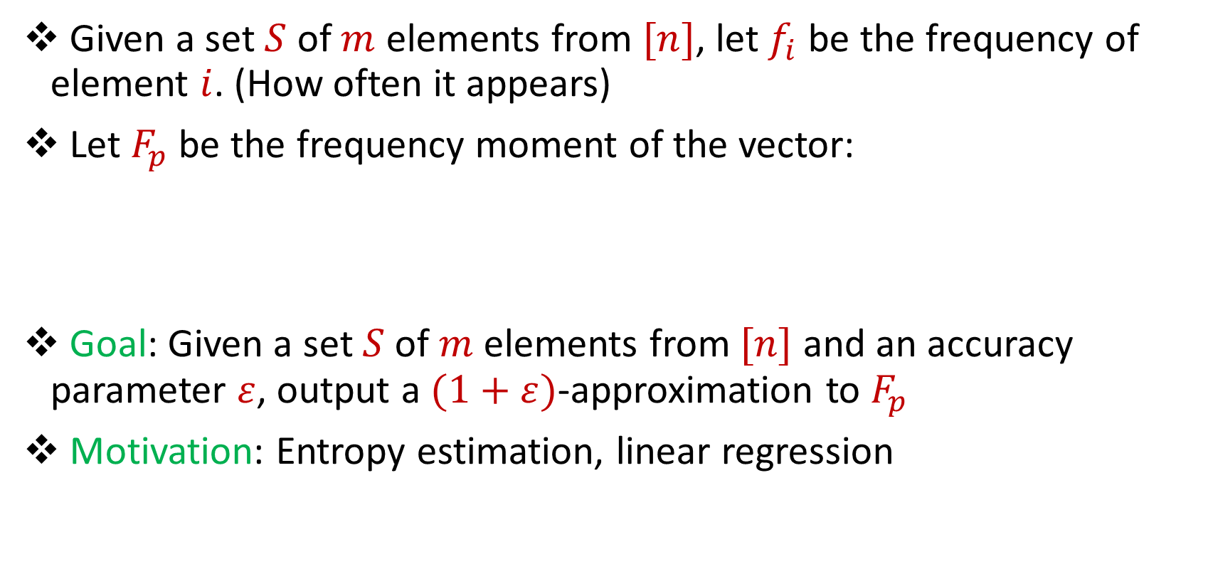
Frequency Moments
Given a set $S$ of $m$ elements from $[n]$, let $f_{i}$ be the frequency of element $i$. (How often it appears)
Let $F_{p}$ be the frequency moment of the vector:
Goal: Given a set $S$ of $m$ elements from $[n]$ and an accuracy parameter $ε$, output a $(1+ε)$-approximation to $F_{p}$
Motivation: Entropy estimation, linear regression
$F_{p}=$ $f_{1}^{p}+f_{2}^{p}+…+f_{n}^{p}$

Slide 6
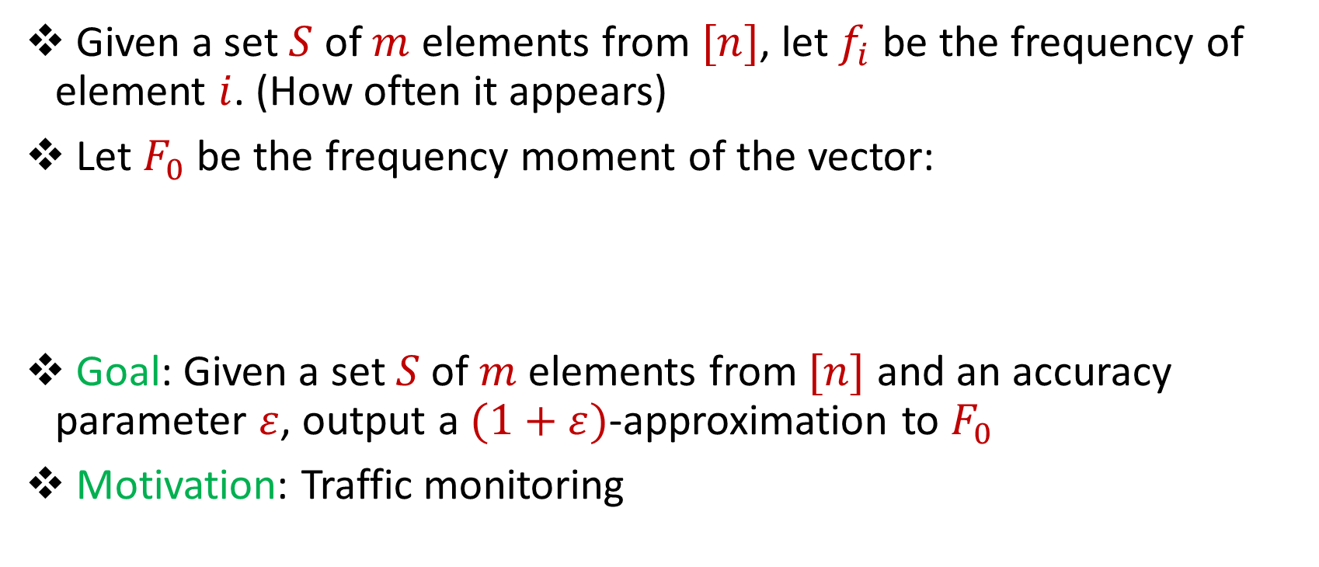
Distinct Elements
Given a set $S$ of $m$ elements from $[n]$, let $f_{i}$ be the frequency of element $i$. (How often it appears)
Let $F_{0}$ be the frequency moment of the vector:
Goal: Given a set $S$ of $m$ elements from $[n]$ and an accuracy parameter $ε$, output a $(1+ε)$-approximation to $F_{0}$
Motivation: Traffic monitoring
$F_{0}=$ $|\{i :f_{i}≠0\}|$

Slide 7
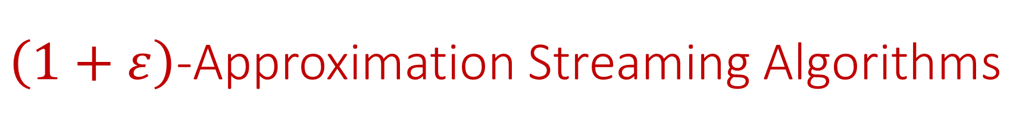
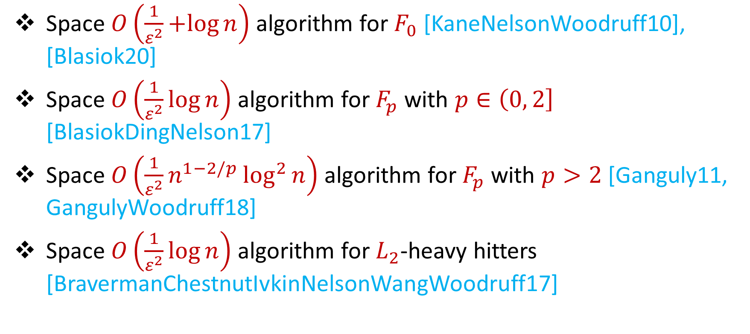
$\left(1+ε\right)$-Approximation Streaming Algorithms
Space $O\left(\frac{1}{ε^{2}}+log{n}\right)$ algorithm for $F_{0}$ [KaneNelsonWoodruff10], [Blasiok20]
Space $O\left(\frac{1}{ε^{2}}\log{n}\right)$ algorithm for $F_{p}$ with $p∈\left(0, 2\right]$ [BlasiokDingNelson17]
Space $O\left(\frac{1}{ε^{2}}n^{1−2/p}\log^{2}{n}\right)$ algorithm for $F_{p}$ with $p>2$ [Ganguly11, GangulyWoodruff18]
Space $O\left(\frac{1}{ε^{2}}\log{n}\right)$ algorithm for $L_{2}$-heavy hitters [BravermanChestnutIvkinNelsonWangWoodruff17]

Slide 8



Model #2: Adversarially Robust Streaming
Input: Elements of an underlying data set $S$, which arrives sequentially and adversarially
Output: Evaluation (or approximation) of a given function
Goal: Use space sublinear in the size $m$of the input $S$
1
1
Notes:
Let’s start by breaking down each of the terms in the title. To understand the sliding window model, we first have to understand the streaming model of computation, in which elements of an underlying data set S, arrive sequentially and the goal is to evaluate or approximate some given function on this dataset, using space sublinear in S. In the sliding window model, only the W most recent updates form the underlying data set

Slide 9
Model #2: Adversarially Robust Streaming
Input: Elements of an underlying data set $S$, which arrives sequentially and adversarially
Output: Evaluation (or approximation) of a given function
Goal: Use space sublinear in the size $m$of the input $S$
10
1
Notes:
Let’s start by breaking down each of the terms in the title. To understand the sliding window model, we first have to understand the streaming model of computation, in which elements of an underlying data set S, arrive sequentially and the goal is to evaluate or approximate some given function on this dataset, using space sublinear in S. In the sliding window model, only the W most recent updates form the underlying data set

Slide 10
Model #2: Adversarially Robust Streaming
Input: Elements of an underlying data set $S$, which arrives sequentially and adversarially
Output: Evaluation (or approximation) of a given function
Goal: Use space sublinear in the size $m$of the input $S$
101
2
Notes:
Let’s start by breaking down each of the terms in the title. To understand the sliding window model, we first have to understand the streaming model of computation, in which elements of an underlying data set S, arrive sequentially and the goal is to evaluate or approximate some given function on this dataset, using space sublinear in S. In the sliding window model, only the W most recent updates form the underlying data set

Slide 11
Model #2: Adversarially Robust Streaming
Input: Elements of an underlying data set $S$, which arrives sequentially and adversarially
Output: Evaluation (or approximation) of a given function
Goal: Use space sublinear in the size $m$of the input $S$
1010
3
Notes:
Let’s start by breaking down each of the terms in the title. To understand the sliding window model, we first have to understand the streaming model of computation, in which elements of an underlying data set S, arrive sequentially and the goal is to evaluate or approximate some given function on this dataset, using space sublinear in S. In the sliding window model, only the W most recent updates form the underlying data set

Slide 12

Model #2: Adversarially Robust Streaming
Input: Elements of an underlying data set $S$, which arrives sequentially and adversarially
Output: Evaluation (or approximation) of a given function
Goal: Use space sublinear in the size $m$of the input $S$
1010
3
Notes:
Let’s start by breaking down each of the terms in the title. To understand the sliding window model, we first have to understand the streaming model of computation, in which elements of an underlying data set S, arrive sequentially and the goal is to evaluate or approximate some given function on this dataset, using space sublinear in S. In the sliding window model, only the W most recent updates form the underlying data set

Slide 13
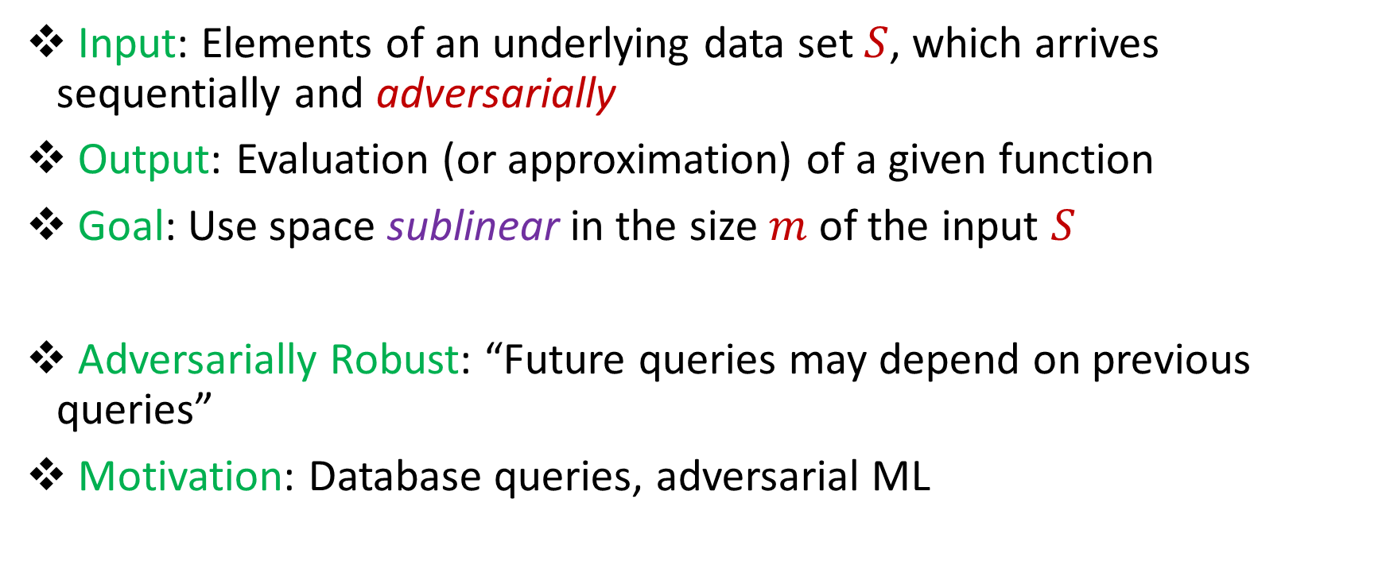
Model #2: Adversarially Robust Streaming
Input: Elements of an underlying data set $S$, which arrives sequentially and adversarially
Output: Evaluation (or approximation) of a given function
Goal: Use space sublinear in the size $m$of the input $S$
Adversarially Robust: “Future queries may depend on previous queries”
Motivation: Database queries, adversarial ML
Notes:
Let’s start by breaking down each of the terms in the title. To understand the sliding window model, we first have to understand the streaming model of computation, in which elements of an underlying data set S, arrive sequentially and the goal is to evaluate or approximate some given function on this dataset, using space sublinear in S. In the sliding window model, only the W most recent updates form the underlying data set

Slide 14
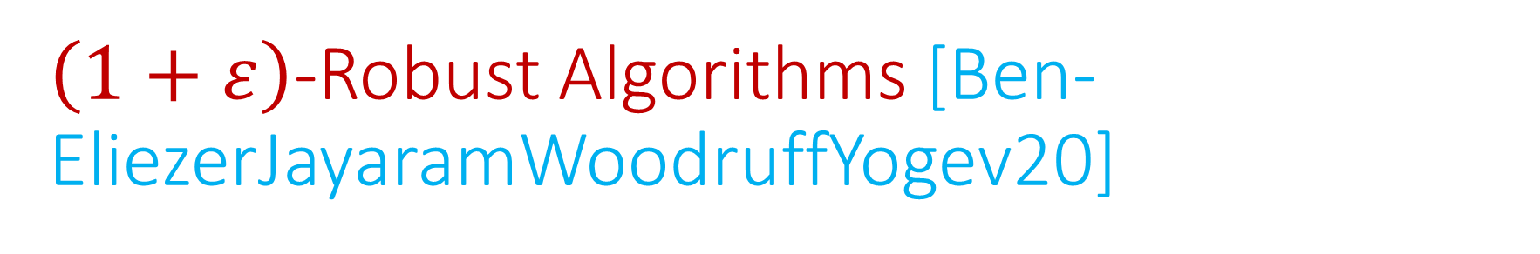
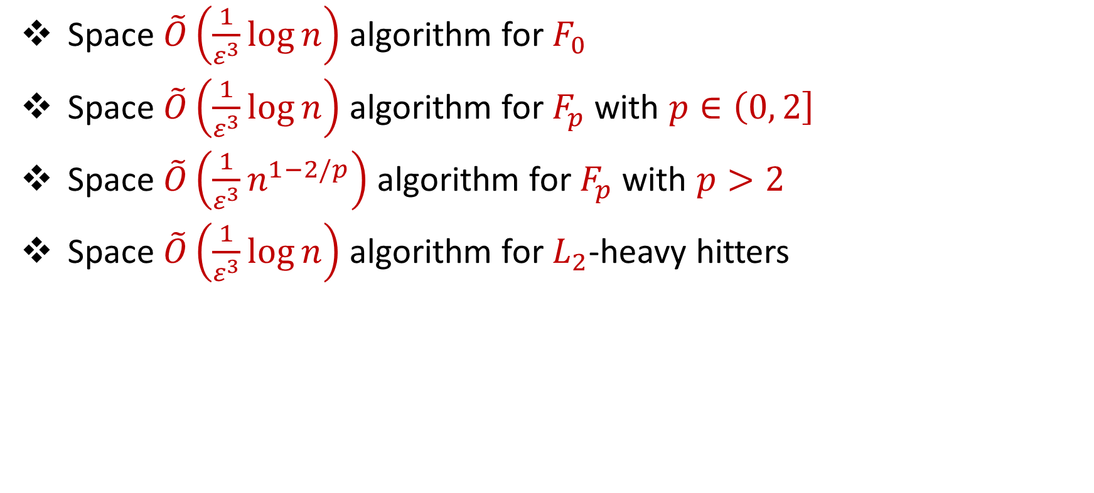
$\left(1+ε\right)$-Robust Algorithms [Ben-EliezerJayaramWoodruffYogev20]
Space $\tilde{O}\left(\frac{1}{ε^{3}}\log{n}\right)$ algorithm for $F_{0}$
Space $\tilde{O}\left(\frac{1}{ε^{3}}\log{n}\right)$ algorithm for $F_{p}$ with $p∈\left(0, 2\right]$
Space $\tilde{O}\left(\frac{1}{ε^{3}}n^{1−2/p}\right)$ algorithm for $F_{p}$ with $p>2$
Space $\tilde{O}\left(\frac{1}{ε^{3}}\log{n}\right)$ algorithm for $L_{2}$-heavy hitters
“A general framework that loses* nothing in $n$ and only $\frac{1}{ε}$ ”

Slide 15
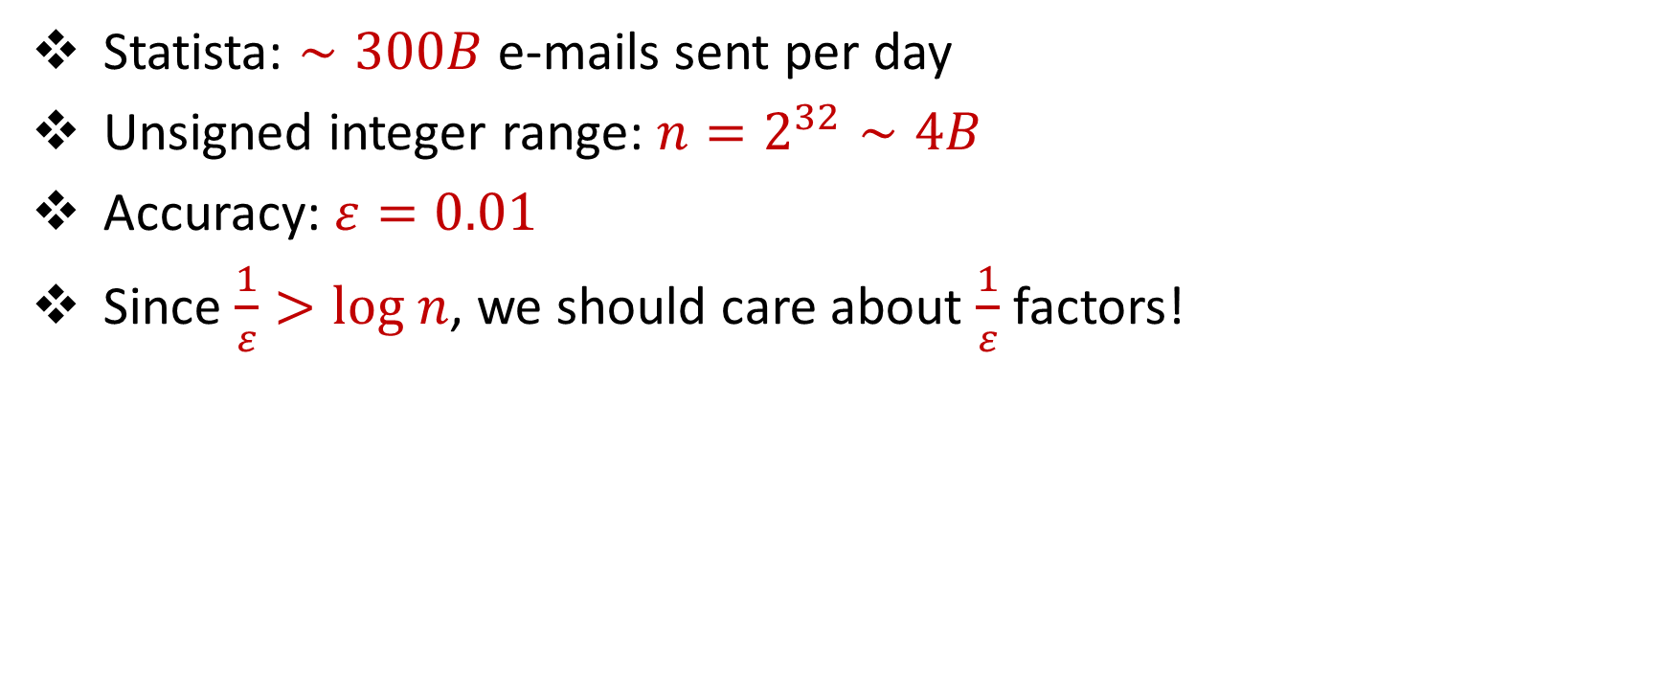
“What’s an epsilon between friends?
Statista: $∼300B$ e-mails sent per day
Unsigned integer range: $n=2^{32}∼4B$
Accuracy: $ε=0.01$
Since $\frac{1}{ε}>log n$, we should care about $\frac{1}{ε}$ factors!

Slide 16
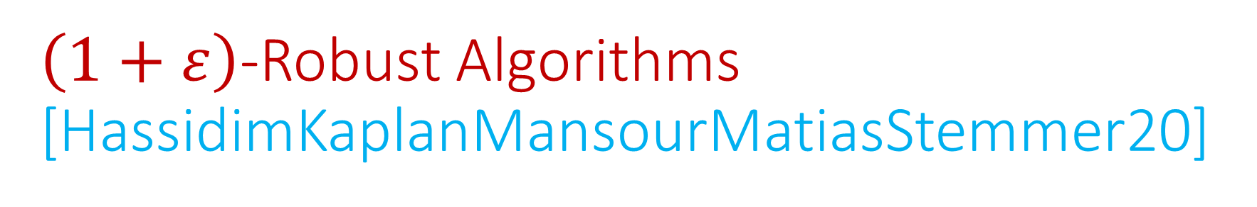
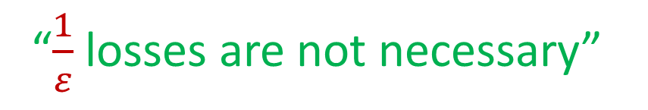
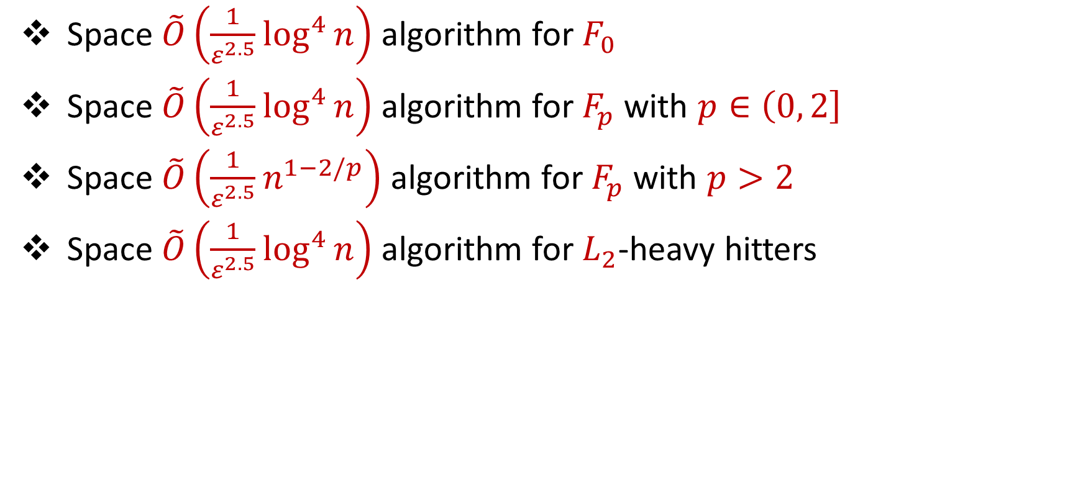
$\left(1+ε\right)$-Robust Algorithms [HassidimKaplanMansourMatiasStemmer20]
Space $\tilde{O}\left(\frac{1}{ε^{2.5}}\log^{4}{n}\right)$ algorithm for $F_{0}$
Space $\tilde{O}\left(\frac{1}{ε^{2.5}}\log^{4}{n}\right)$ algorithm for $F_{p}$ with $p∈\left(0, 2\right]$
Space $\tilde{O}\left(\frac{1}{ε^{2.5}}n^{1−2/p}\right)$ algorithm for $F_{p}$ with $p>2$
Space $\tilde{O}\left(\frac{1}{ε^{2.5}}\log^{4}{n}\right)$ algorithm for $L_{2}$-heavy hitters
“$\frac{1}{ε}$ losses are not necessary”

Slide 17




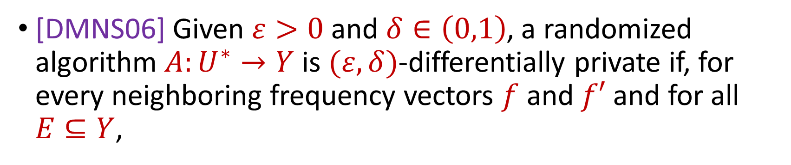

Differential Privacy
[DMNS06] Given $ε>0$and $δ∈\left(0,1\right)$, a randomized algorithm $A:U^{∗}→Y$ is $(ε,δ)$-differentially private if, for every neighboring frequency vectors $f$ and $f′$ and for all $E⊆Y$,
$$Pr\left[A\left(f\right)∈E\right]≤e^{ε}Pr\left[A\left(f^{′}\right)∈E\right]+δ$$
$$A\left( \right)≈A\left( \right)$$
Notes:
[DworkMcSherryNissimSmith06]

Slide 18


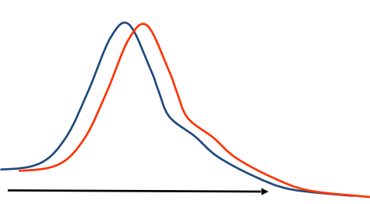
Differential Privacy
[DMNS06] Given $ε>0$and $δ∈\left(0,1\right)$, a randomized algorithm $A:U^{∗}→Y$ is $(ε,δ)$-differentially private if, for every neighboring frequency vectors $f$ and $f′$ and for all $E⊆Y$,
$$Pr\left[A\left(f\right)∈E\right]≤e^{ε}Pr\left[A\left(f^{′}\right)∈E\right]+δ$$
Sensitive dataset
Algorithm
Output distribution
Notes:
[DworkMcSherryNissimSmith06]

Slide 19
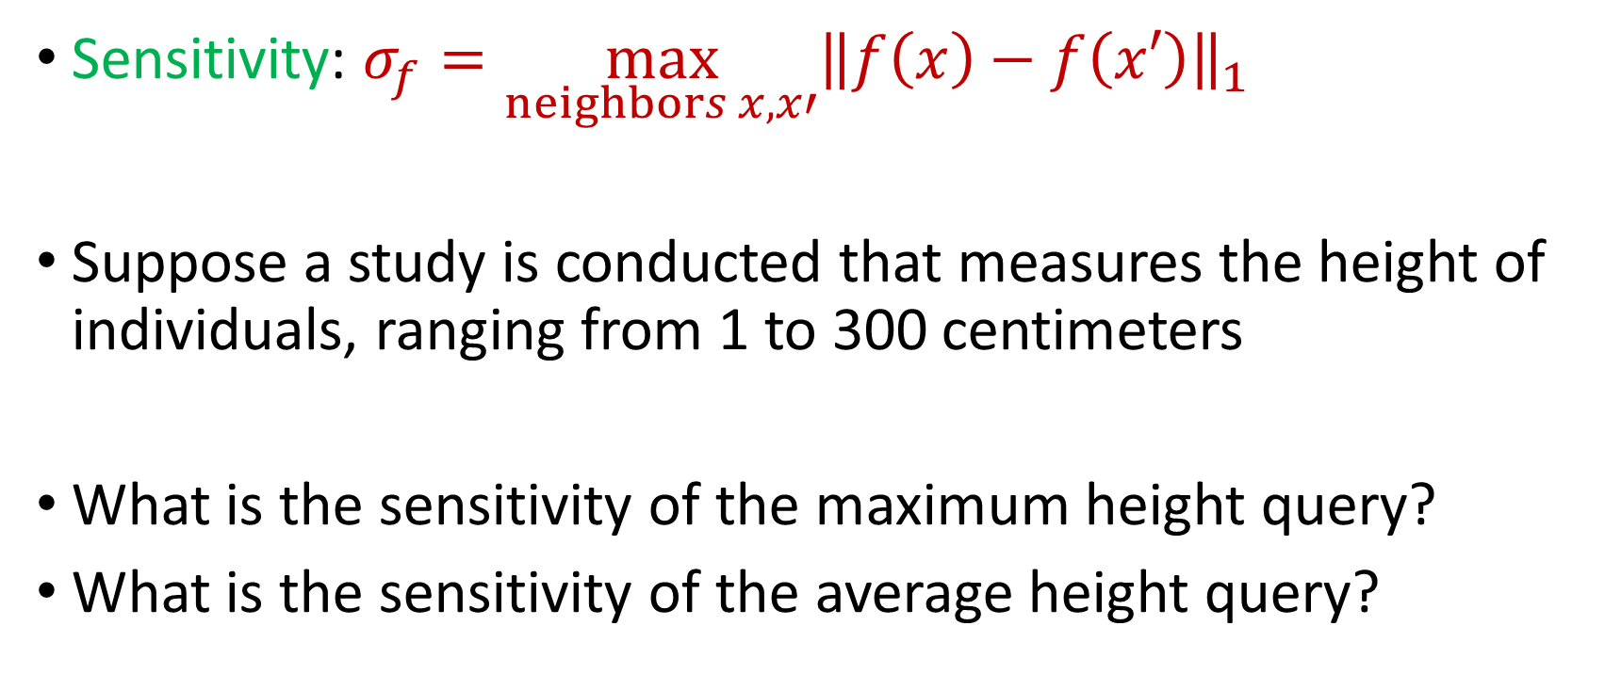
Sensitivity
Sensitivity: $σ_{f}=\max_{neighbors x,x′}{\left\|f\left(x\right)−f\left(x′\right)\right\|}_{1}$
Suppose a study is conducted that measures the height of individuals, ranging from 1 to 300 centimeters
What is the sensitivity of the maximum height query?
What is the sensitivity of the average height query?
Notes:
[DworkMcSherryNissimSmith06]

Slide 20
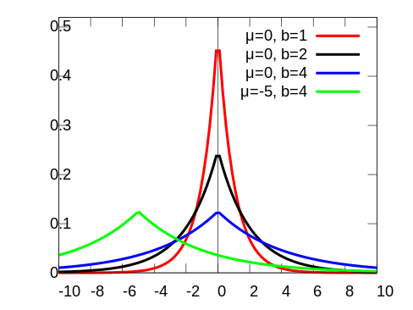
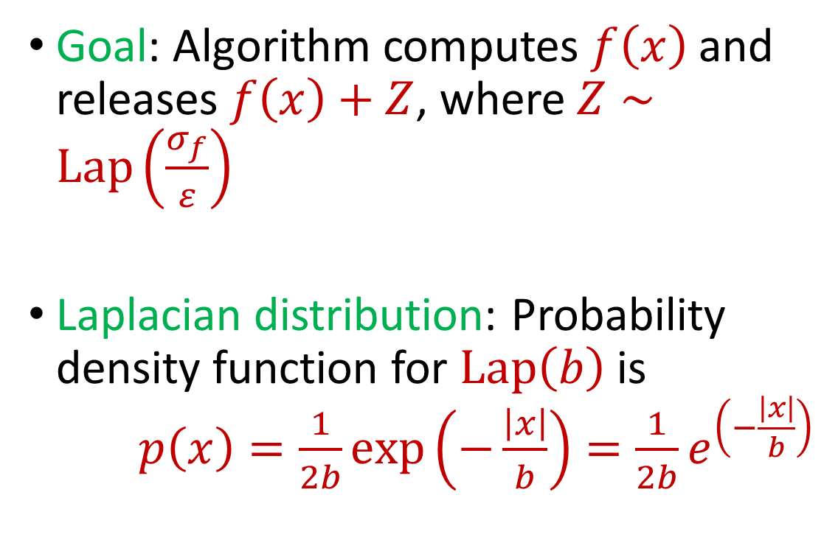
Laplace Mechanism
Goal: Algorithm computes $f\left(x\right)$ and releases $f\left(x\right)+Z$, where $Z∼Lap\left(\frac{σ_{f}}{ε}\right)$
Laplacian distribution: Probability density function for $Lap\left(b\right)$ is $p\left(x\right)=\frac{1}{2b}exp\left(−\frac{\left|x\right|}{b}\right)=\frac{1}{2b}e^{\left(−\frac{\left|x\right|}{b}\right)}$
Notes:
[DworkMcSherryNissimSmith06]

Slide 21
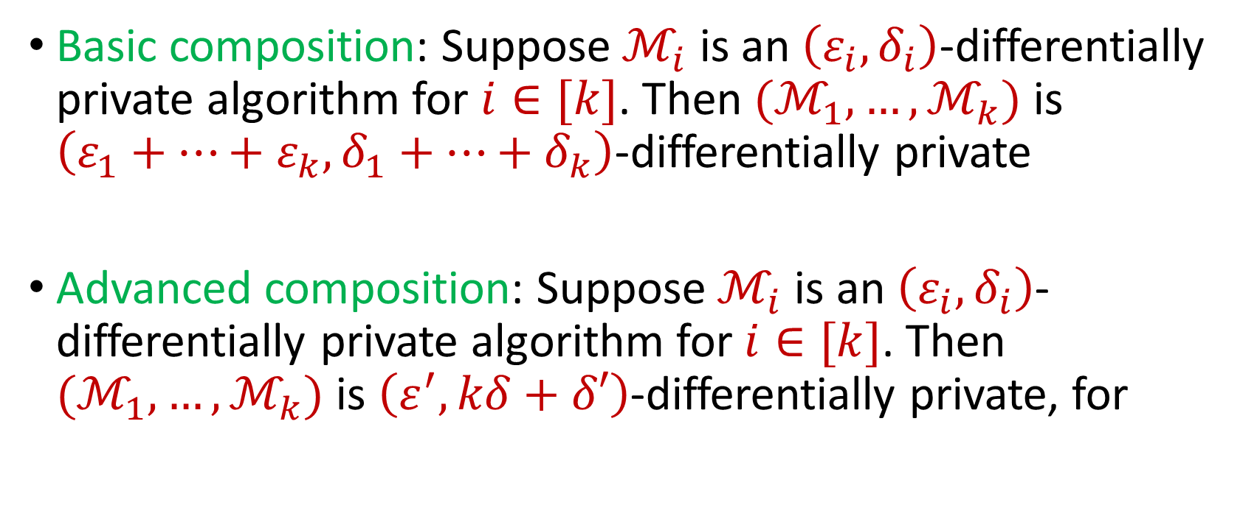
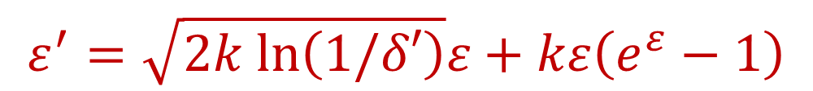
Composition Theorems
Basic composition: Suppose $ℳ_{i}$ is an $\left(ε_{i},δ_{i}\right)$-differentially private algorithm for $i∈[k]$. Then $(ℳ_{1},…,ℳ_{k})$ is $\left(ε_{1}+…+ε_{k},δ_{1}+…+δ_{k}\right)$-differentially private
Advanced composition: Suppose $ℳ_{i}$ is an $\left(ε_{i},δ_{i}\right)$-differentially private algorithm for $i∈[k]$. Then $(ℳ_{1},…,ℳ_{k})$ is $\left(ε^{′},kδ+δ′\right)$-differentially private, for
$$ε^{′}=\sqrt{2k ln\left(1/δ′\right)}ε+kε\left(e^{ε}−1\right)$$
Notes:
[DworkMcSherryNissimSmith06]

